Slide 1

SpoofyTrash: AI-Powered Waste Management
ACE Hack 4.0 Submission by Phantompulse. We present SpoofyTrash, an AI-driven solution optimizing urban waste management for cleaner, healthier cities.

Slide 2
Project Overview
Core Components
Objective
OpenCV for garbage detection
Optimize urban waste management and ensure cleaner environments using AI.
Firebase for complaint tracking
Twilio for cleaner alerts

Slide 3




The Problem
Environmental Hazards
Inefficient Tracking
Lack of real-time tracking exacerbates waste management issues.
Waste accumulation impacts public health and city aesthetics.
Cleaning Mechanisms
Current cleaning processes are inefficient and slow.

Slide 4





Our Solution: SpoofyTrash
AI Detection
Identify waste with OpenCV algorithms.
Instant Alerts
Send alerts to cleaners via Twilio SMS/call.
Complaint Filing
Users file complaints via Firebase.
Real-Time Tracking
Provide tracking and analytics.

Slide 5





Unique Selling Proposition
AI-Powered
Automated Notifications
Complaint System
Data Insights
Our system offers AI-powered detection, automated notifications, a complaint system, data insights, and is easily scalable for various infrastructures.

Slide 6




Technical Architecture
Dashboard
1
Real-time waste tracking
Firebase
2
Stores complaints
Twilio API
3
Sends alerts
OpenCV
4
Detects waste

Slide 7
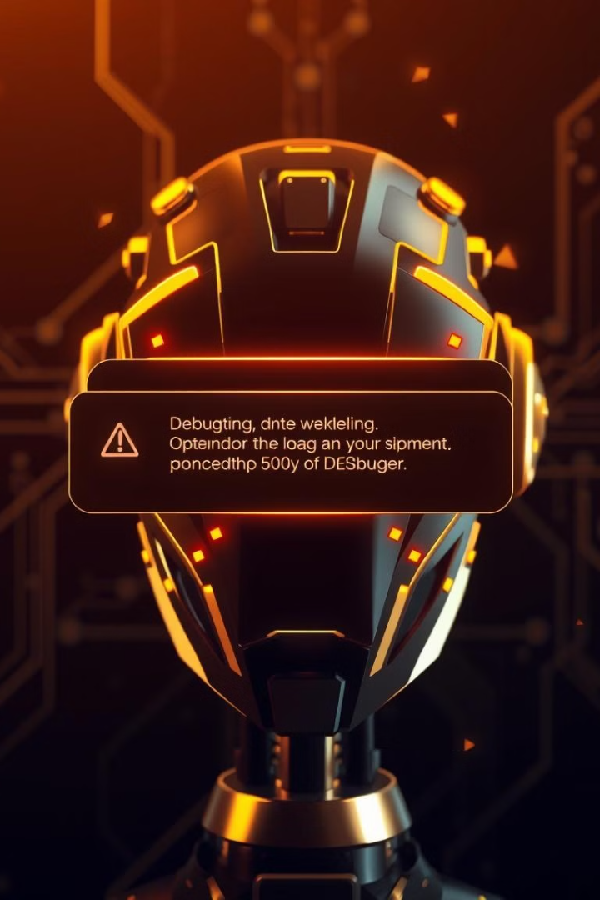
Challenges & Solutions
Detection Accuracy
Notification Delays
Improved precision using advanced AI models.
Optimized Twilio API for faster alerts.
User Engagement
Developed an intuitive interface for complaint registration.

Slide 8




Future Enhancements
IoT Integration
Sensor-based waste monitoring
AI Segregation
AI-powered waste segregation
City Expansion
Collaboration model with cities

Slide 9

Conclusion & Call to Action
95%
70%
80%
Efficiency
Reduction
Cleaner
Increase in waste management efficiency.
Reduction in environmental hazards.
More effective and cleaner streets
Join us in revolutionizing waste management. Let's make cities cleaner and more efficient together!

